Slide 1



WEB COMMITTEE
Session (1)

Slide 2
Intro
Who am I ?
Who are you?

Slide 3
Topics of day
The difference between frontend and backend
Basics of any website ( URL , HTTP&HTTPS , WWW )
Client to server model ( Request/ Response , IP , DNS)
HTML definition and structure page
Meta elements
VS code installation
HTML Basic vocabulary : headings , paragraph , Break , horizontal line

Slide 4


Frontend vs Backend
VS
User interface
Program code
What human / user interact directly with
Buttons
Programs
Websites
Logic of program (how program works)
Functions
Storage
Authentcation

Slide 5
Frontend vs Backend
VS
Components
handles
Html
CSS
JavaScript
Database interactions
Server configurations
Server-side languages

Slide 6
Frontend vs Backend
VS
Runs
Runs
on browsers
On servers

Slide 7
Basics of any website
URL ( Uniform Resource Locator) :
Web address of a given unique resource on the web , each URL points to unique components as HTML pages , CSS document , img …etc
What does URL Formed of :
https://www.google.com

Slide 8
Basics of any website
1. http ( Hypertext Transfer Protocol) :
Standard language used to communicate between web browser and website servers
NOTE : https : provides more security
2. www ( World Wide Web) :
Used mostly as prefix , indicates that a given website users HTTP to communicate
3. .com ( stands for Commercial ) :
Doesn’t need necessarily have to have commercial purpose , can use other domains instead like ( .org , .edu , .gov )

Slide 9
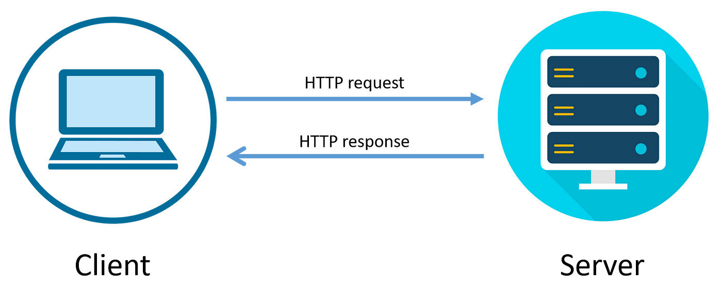
Client to server model
Client
Server
HTTP Request
HTTP Response
What is the Request / Response?
Request : message that arrives to server for request something
Response : message that sends from server to client for request something

Slide 10
Client to server model
Client
Server
IP (Internet Protocol) address :
HTTP Request
set of rules for communication over internet (streaming , send mails)
IP address identifies a network or device that connected to internet
HTTP Response
DNS (Domain Name System) :
Internet system for converting alphabetical address (URL) to numerical IP address

Slide 11

Activity Time

Slide 12
HTML
What is HTML?
HTML stands for Hyper Text Markup Language
Standard markup language for web pages
HTML elements represented by tags <>
What is HTML element ?
each HTML element has an start tag and an end tag with content between
<start> content </end>

Slide 13
HTML page structure
Essential HTML page structure :
<!DOCTYPE html> : defines this document for hTML5
<html lang="en">: the root element of an HTML page and lang attribute stands for the language of the document
<head>: define head section in html contains meta tags , links files , title of web page
<title> : the name of web page
<body> : define body section in html which carry the visible content in web page

Slide 14
Meta Element & attributes
Meta element <meta> :
defines metadata ( “ information about data”) about an HTML document
Metadata is not displayed on web page but machine parsable

Slide 15
Meta Element & attributes
Meta element attributes:
charset="UTF-8“ : Specifies the character encoding for the HTML document
name="viewport": Specifies a name for the metadata and Viewport is to make website look good in all devices
content="width=device-width": Specifies the value associated with the http-equiv or name attribute

Slide 16
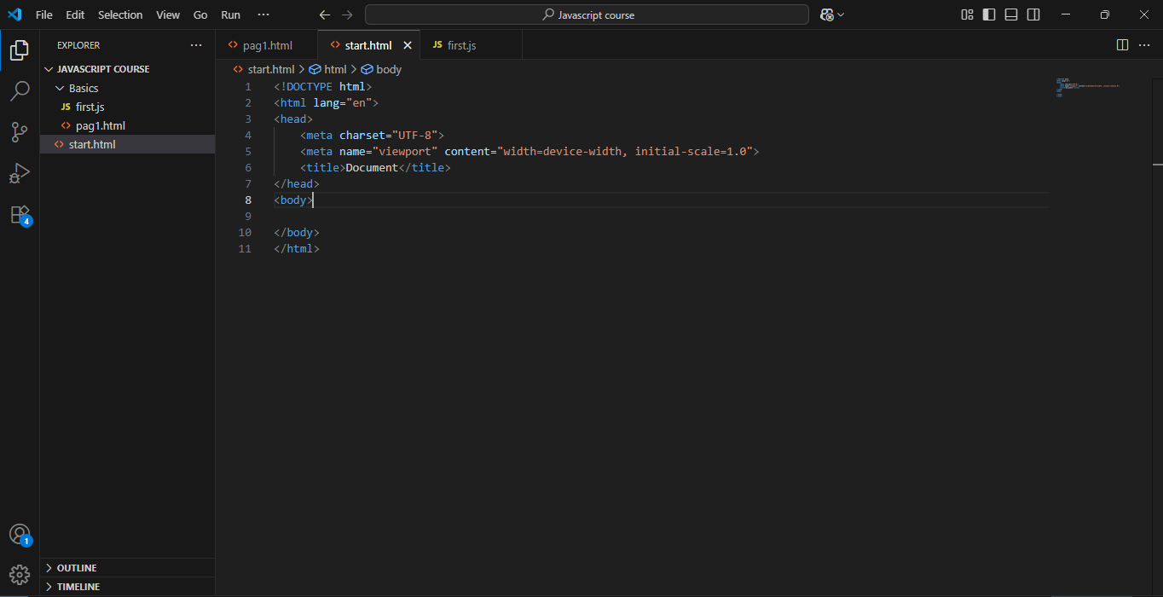

Vs installation
Visual studio code

Slide 17
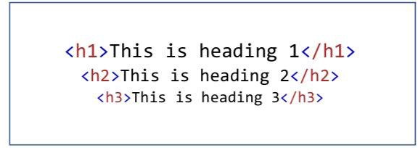
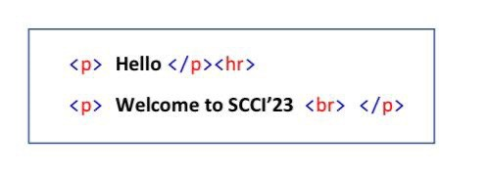
HTML vocabulary
HTML Headings:
From <h1> to <h6> tags
HTML Paragraph , Break & Horizontal

Slide 18


